Slide 1
Reel Tâi-gí siāu-kài
Ēng iáⁿ-phìⁿ o̍h Tâi-oân Lô-má-jī, kiam o̍h Eng-bûn

Slide 2

Bāng-chām tī chia
https://hangkapiphang.github.io/taigi/

Slide 3
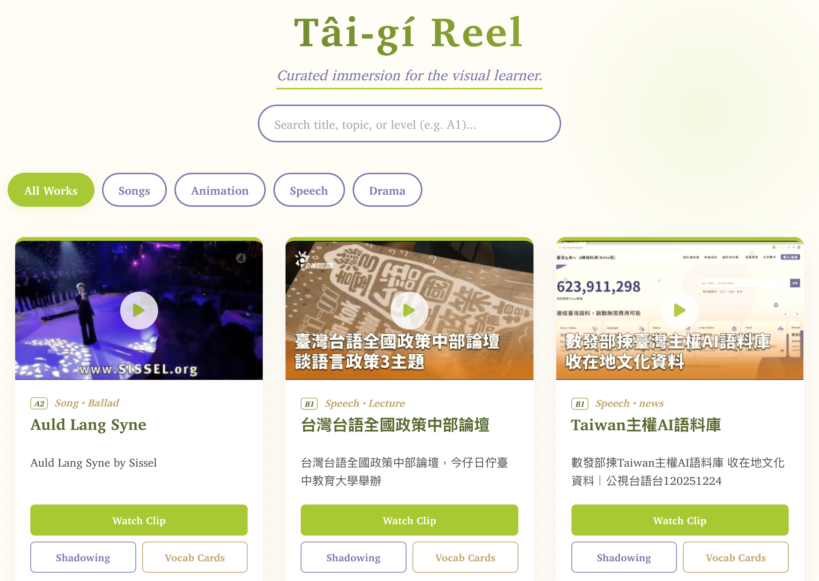
Chin ê?
A̍h kè ê?

Slide 4
Tâi-gí ū liàn-tńg iah bô?

Slide 5
Ē-tàng chhiâu-chhōe!

Slide 6
Ū Hun-lūi!

Slide 7
Tiám “Play” to̍h thang khòaⁿ kap thiaⁿ

Slide 8
Tâi-gí su-lūi, Eng-bûn kái-soeh

Slide 9
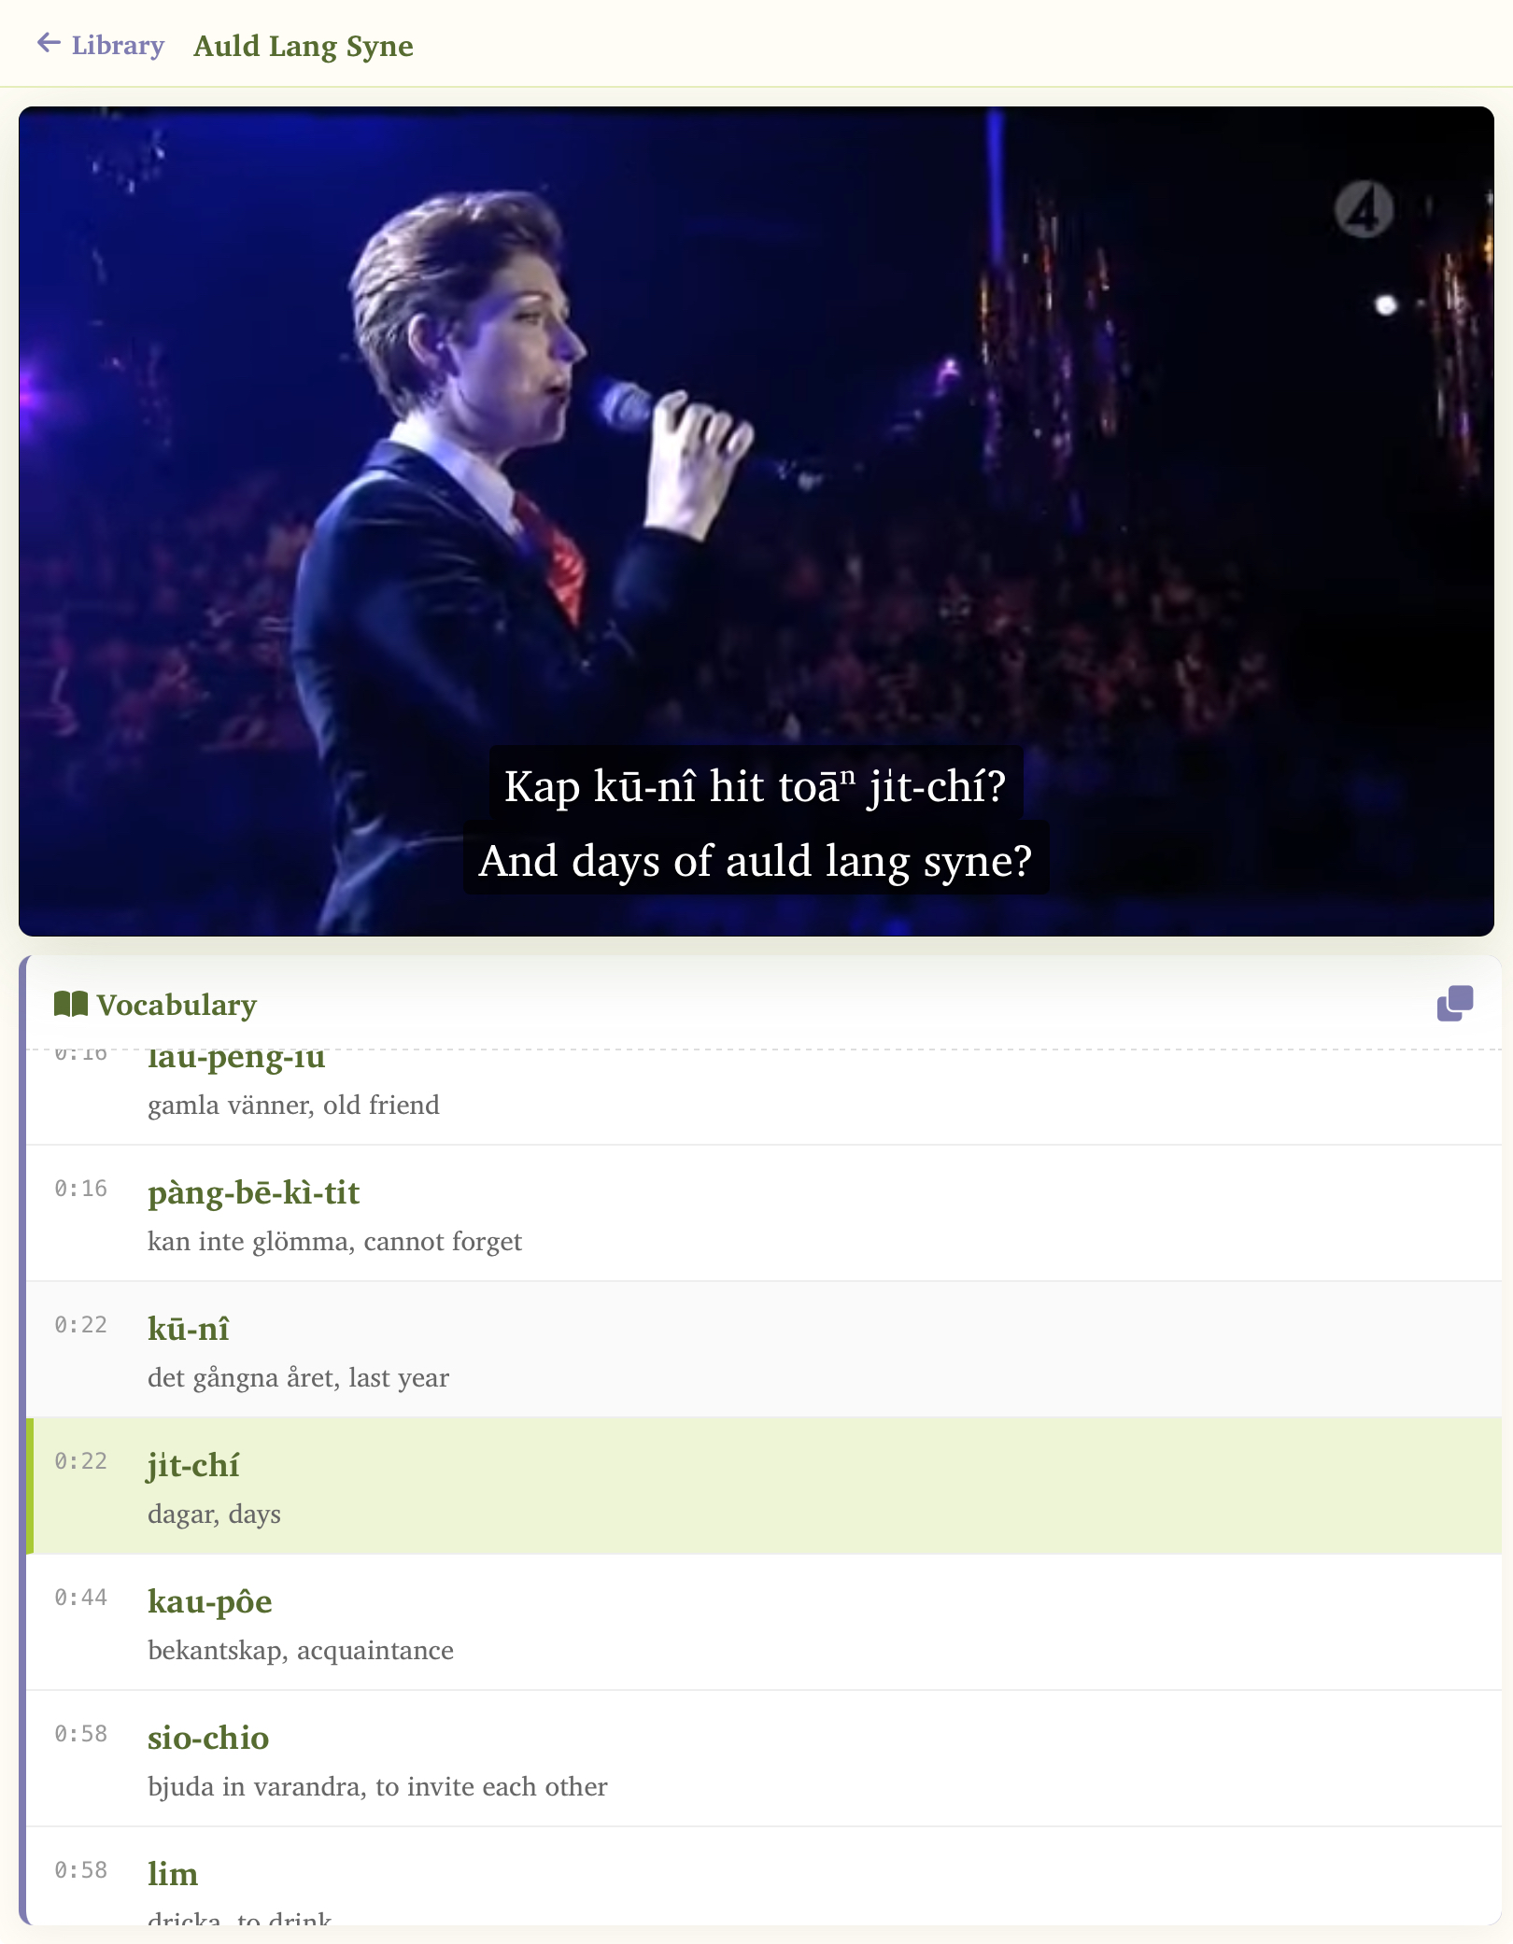
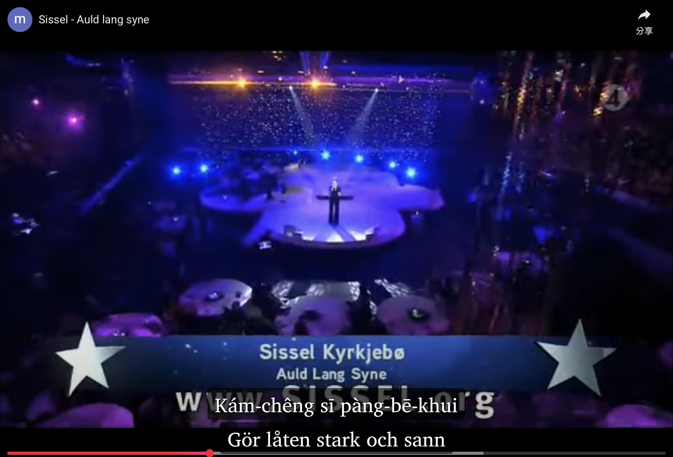

Lóng ē-tàng!
Tiān-náu, Pêⁿ-pán tiān-náu, Chhiú-ki-á; chhāi ti̍t, a̍h-sī hoâiⁿ.

Slide 10
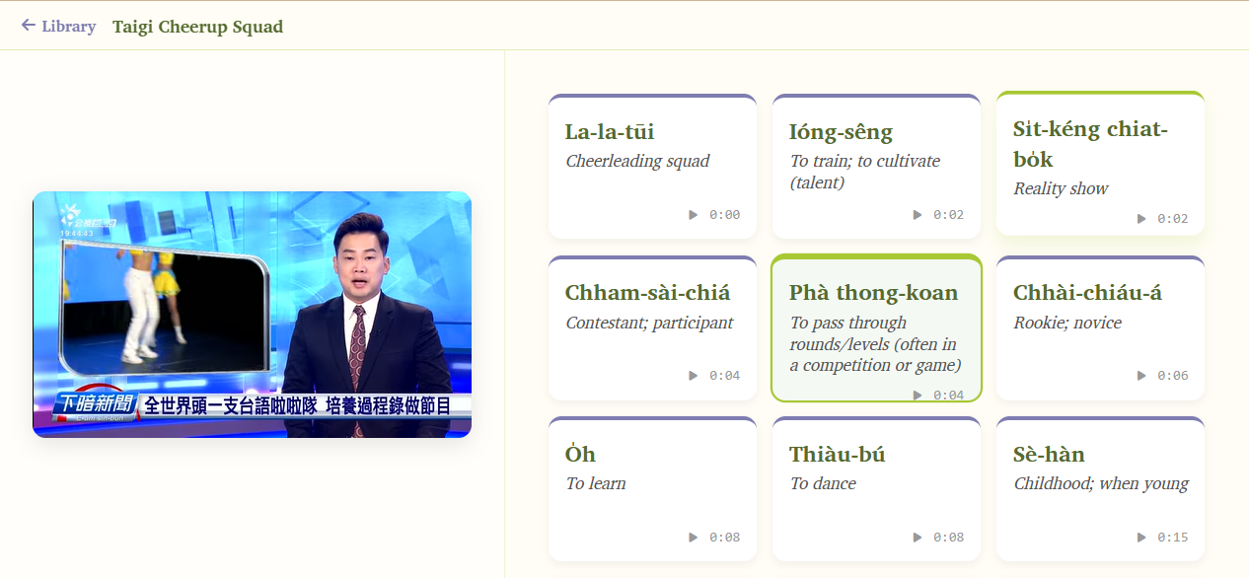
Chè-chok：Âng, Chông-úi

